Slide 1
G2 Bank and ATM System
Group 2:
Kyle Lehman
Mike Norris
Tony Ricco
Steve Zogheb
June 6, 2013

Slide 2
Overview
Assignment specifies connecting one ATM to one bank
Communication protocol designed to scale to many ATM/many Banks

Slide 3
Requirements of ATM security system
Authentication:
The user is the one it claims to be.
Confidentiality:
Only authorized users can access the content of the data.
Integrity:
The data is altered by the third parties during the transmission.

Slide 4
Common Threats
Masquerade, Impersonation, or Spoofing
An entity pretends to be another
Eavesdropping
Communication interception or monitoring
Unauthorized access
An entity attempts to access data in violation of the security policy in force
Loss or Corruption of Information
Data in transit is modified, by insertion, deletion, replay, delay or replacement of segments or complete messages.
Forgery
An entity fabricates information and claims that this information was received or sent from/to another entity

Slide 5
Communication Encryption Protocol Selection Process
Symmetric key use:
Did not meet the real-world requirements
Not reasonable for every ATM to know the secret key of every banking institution with which it may need to communicate
A method for the exchange of keys seemed desirable
Diffie-Hellman Key exchange
Allows key exchange of messages to prevent an eavesdropper from recreating the key by intercepting the handshake messages
does not by itself provide identity authentication
Vulnerable to man-in-the-middle attacks

Slide 6
Communication Encryption Protocol
Modified X.509-like protocol
Not feasible to set up a full-blown X.509 Project Certificate Authority to generate the Authority’s and Bank’s Certificates in the time allotted for this project
Settled on a modified X.509-like protocol using RSA keys and encryption to verify the Bank’s identity and transfer its public key to the ATM

Slide 7
Session Encryption Algorithm Selection
Data Encryption Standard (DES)
not chosen because too insecure
mostly to its 56-bit key size
Advanced Encryption Standard (AES)
chosen for the symmetric key
RSA
Used for key generation
public/private keys

Slide 8
Electronic codebook vs. Cipher-block Chaining
Electronic codebook (ECB)
messages is divided into blocks and each block is encrypted separately.
Disadvantage: identical plaintext blocks are encrypted into identical ciphertext blocks
Doesn't hide data patterns well
Cipher-block Chaining (CBC)
each block of plaintext is XORed with the previous ciphertext block before being encrypted
each ciphertext block depends on all plaintext blocks processed up to that point
To make each message unique, an initialization vector must be used in the first block

Slide 9



ECB vs. CBC
Electronic codebook vs. Cipher-block Chaining

Slide 10
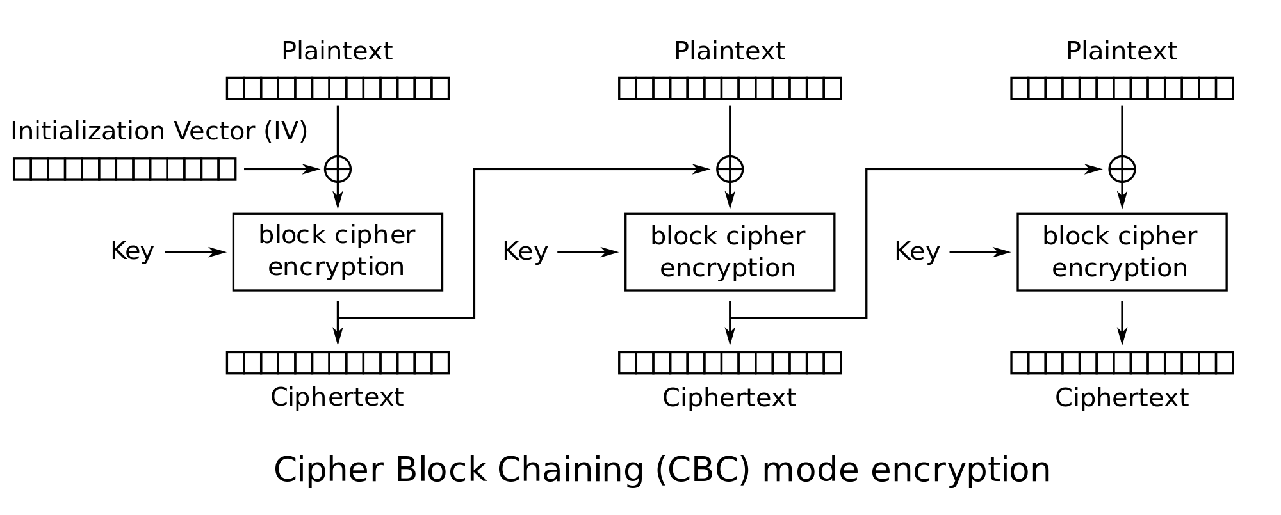
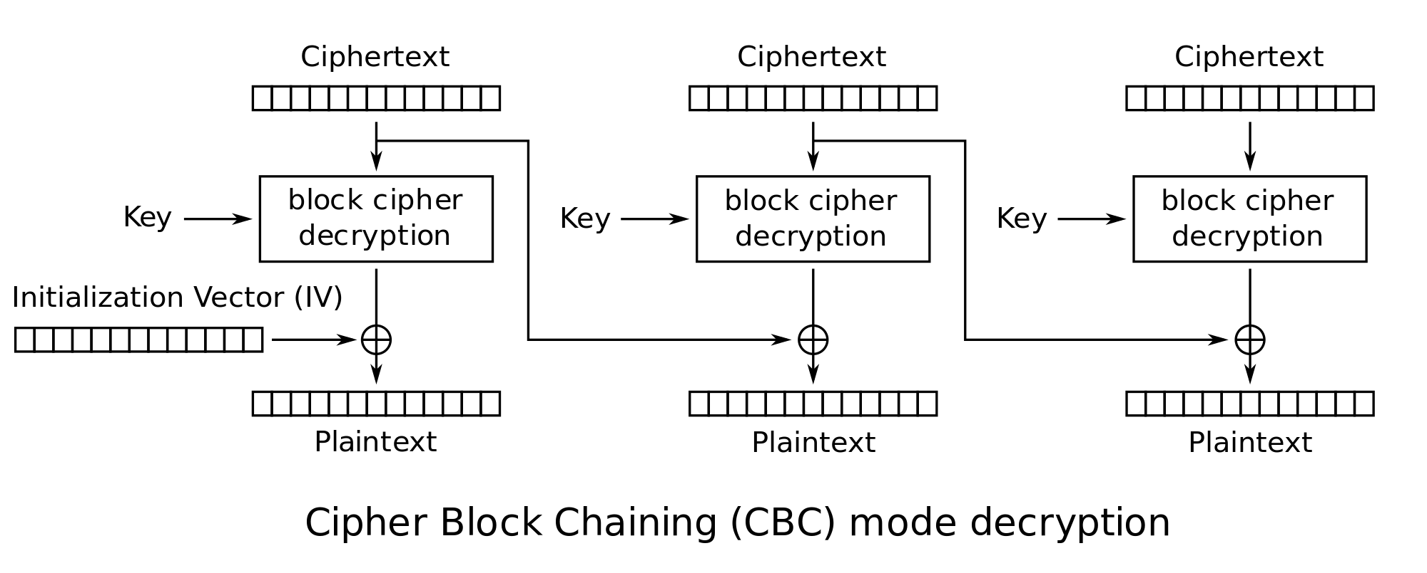
CBC Encryption/Decryption

Slide 11
Main Possible Threats
Brute force
Man-in-the-middle

Slide 12
Security Features
Session IDs
Encryption
RSA
AES
3 Strike Rule
Brute force only takes 30 seconds without
Session timeouts
Session lockouts
Signed/Sealed Objects

Slide 13
Security Protocol Implementation

Slide 14
Certificate Authority (CA)
Generates the Bank certificate and RSA key pairs for the Bank and the Certificate Authority
public key of the Project Certificate Authority acts as the trusted root certificate installed in the ATM
Verifies the bank’s identity with digital certificate

Slide 15
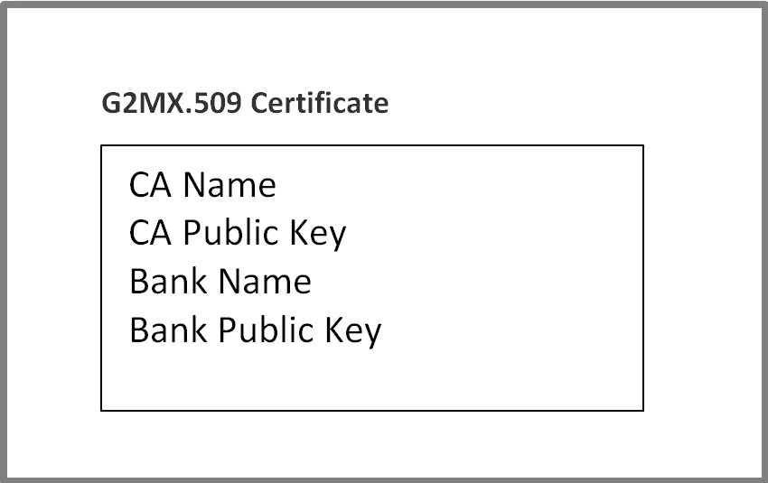
G2 Modified X.509 Certificate Structure

Slide 16
Certificate Validation
A certificate is valid if it passes the following checks.
Using the root CA’s public key (which the ATM implicitly knows), the verify(…) method of the SignedObject returns true.
The CA name in the certificate must match the CA name that the ATM implicitly knows.
The CA Public Key in the certificate must match the root CA Public Key stored in the ATM.
The Bank Name in the certificate must match the name of the Bank the ATM is attempting to communicate with.

Slide 17
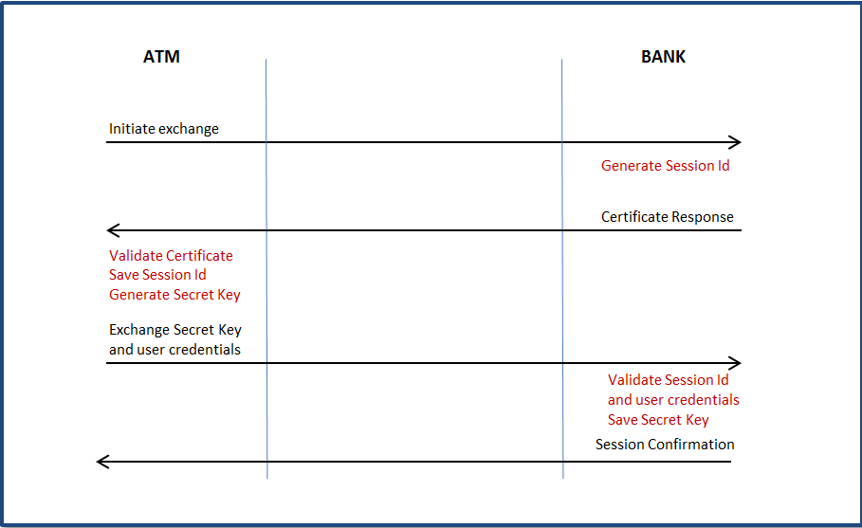
Session ID Key Exchange

Slide 18
Session Handshake
ATM wishes to initiate a session, it first sends an initiate key exchange message.
message sent in the clear
Bank responds with its certificate – contained within a SignedObject - and a unique Session Id for this session
If the Certificate is valid, the ATM saves the session id, generates a session AES key, and encrypts the key along with the card/account information and pin into a Java SealedObject using the RSA public key of the Bank which it obtained from the certificate.
The bank decodes the message with its private key, validates that the Session Id matches the one it sent with the certificate, validates the user account and pin information and save the secret key for all future communication under that session
It then sends a confirmation message to the ATM.
That message will either inform the ATM that the user information is valid - the ATM can proceed to send session messages - or that the user information is invalid and the session should be terminated.

Slide 19
Session IDs
Session created for each ATM connection to the bank
unique Session Id for session
Created by the bank
Validated by the bank

Slide 20
Session Communication
AES encryption
Sensitive pin info protect by RSA
No critical information in session messages
Limit Vulnerability:
3-Strikes-you’re-out
Session timeout

Slide 21
Summary
ATM technology very complex
G2 System unhackable!!!!

Slide 22
References
http://www.theinquirer.net/inquirer/news/2102435/aes-encryption-cracked
https://en.wikipedia.org/wiki/Block_cipher_mode_of_operation

Slide 23
Questions?

